Slide 1
Home Sweet Home

Slide 2
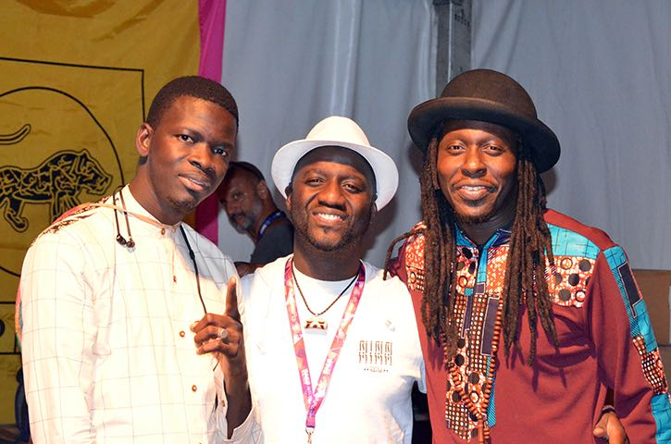
N'Dongo D
Seckou Keita
Faada Freddy

Slide 3
Senegalese Rap Duo, Daara J (Faada Freddy and N’Dongo D)

Slide 4
Click on the links to hear the tracks
Home Sweet Home – without rap vocals
Home Sweet Home – kora and piano

